Slide 1
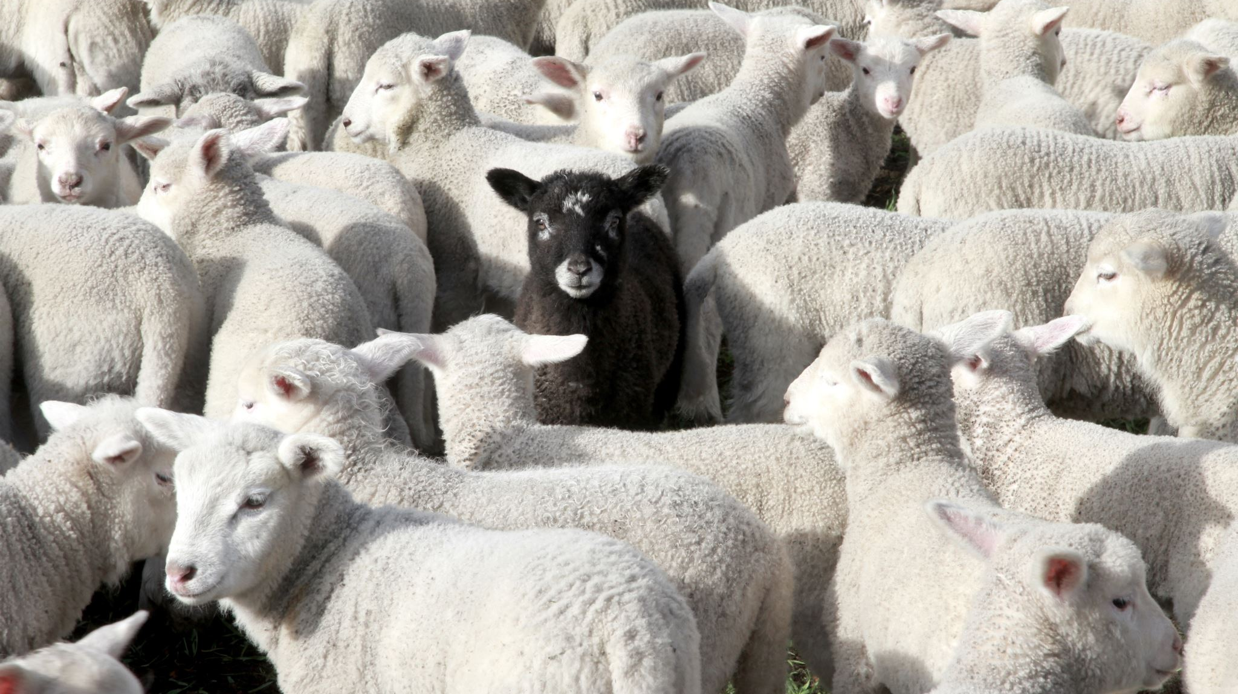

Sheep Breed Classification Using CNN (ResNet50 & VGG19)
- Tilak Jilka

Slide 2
Problem Statement
Manual classification of sheep breeds is time-consuming and error-prone.
Objective: Automate sheep breed recognition using deep learning.
Goal: Achieve high accuracy using pre-trained CNN models.

Slide 3
Dataset Overview
Dataset: Images of 4 sheep breeds
Marino
White Suffolk
Poll Dorset
Suffolk
Images collected from separate folders for each breed
Total Images: 1158 (All combined)

Slide 4
Data Preprocessing
Read images using OpenCV (cv2).
Resized all images to uniform shape (150x150).
Normalized pixel values (scaled between 0–1).
Label encoded breed names → integer classes.
One-hot encoded labels for model training.

Slide 5
Model 1 – ResNet50
Used transfer learning
Pre-trained on ImageNet
Top layer removed (include_top=False)
Custom classifier added: Flatten → Dense(4, softmax)
ResNet layers frozen (not retrained)

Slide 6
Model 2 – VGG19
Similar setup to ResNet50
Pre-trained VGG19 as feature extractor
Custom Dense layer for 4-class prediction
Also used transfer learning

Slide 7

Training Setup
Loss: categorical_crossentropy
Optimizer: Adam
Epochs: Up to 25 (early stopping used)
Batch Size: 64
Callbacks: ModelCheckpoint, EarlyStopping

Slide 8
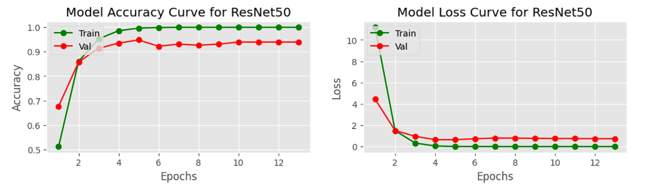
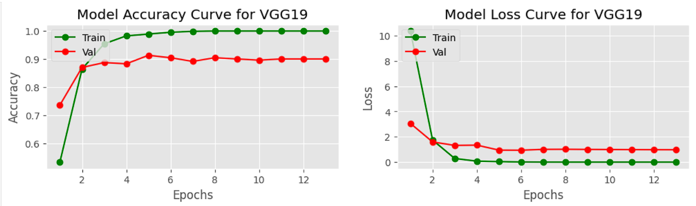

Slide 9
Conclusion
ResNet50 slightly better than VGG19
Transfer learning effective for small image datasets

